Slide 1
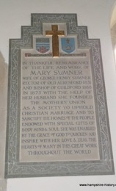
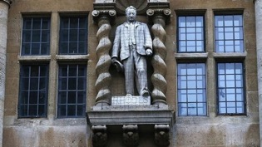
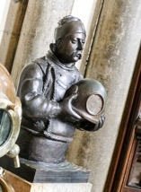
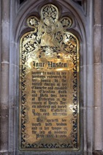
The Mark of the Conservation Professional
“Forget me Not”
Where
Wessex Centre, Winchester Cathedral, The Close Winchester Hampshire SO23 9LS
When
September 20th 2019
An IHBC South Branch conference exploring the management of memorials and key conservation issues
See next page for detailed itinerary

Slide 2
Wessex Centre, Winchester Cathedral, The Close, Winchester, Hampshire, SO23 9LS
Time | Speaker | Job Title | Topic
9-15am | Tea / Coffee / Registration
9-30am - 9-40am | Jonathan Clarke | Chairman IHBC South Branch | Introduction & Welcome
9-40am – 10-20am | Diana Coulter | Church Buildings Adviser, Artemis Heritage | The strange case of Dr Oliver: Listed monuments at All Saints Weston in Bath
10-20am – 11-05am | Julie Adams | Julie Adams is a voluntary guide at Winchester Cathedral. | Winchester Cathedral: A Place of Remembrance
11-05am – 11-20am | Coffee / Tea Break
11-25am – 12.10 pm | Emily Gee | Historic England | Commemorating Different issues and Contested History
12-10 - 12-55pm | Frank Green | Building Conservation Officer | Securing the Future of Churchyard Monuments
12-55pm | Lunch
1-30pm | Guided tour of specific Winchester Cathedral Memorial
2-15pm to 3-00pm | Dr Ian Dungavell | Chief executive of the Friends of Highgate Cemetery Trust and formerly director of the Victorian Society | Rest in peace? Why re-using graves is crucial to saving our cemetery heritage
3-00pm to 3-30pm | John Gedling | Director of Works War Graves Commission | The challenges of managing such a large memorial estate, mainly in France and Belgium
3-30pm | Tea & Conference Close
As with many historic cities, parking within the centre is limited and often congested. Winchester has excellent rail and bus links to London, Southampton, Basingstoke, Reading, the Midlands and beyond. Where possible we strongly advise people to make use of these facilities.

Slide 3
Speaker Biographies
Diana Coulter
From 2010-2014, Diana Coulter was a casework officer for the Church Buildings Council and managed its programme of Wolfson-funded fabric repair grants. Since 2014, she has been engaged in heritage consultancy at Artemis Heritage as well as researching the stained glass of Keith New, designer of three of the nave windows at Coventry Cathedral (co-authored monograph Keith New: British modernist in stained glass published by Sansom in 2018). All Saints Weston is a long-running and complex project that started for Artemis Heritage in 2016; Artemis produced a Statement of Significance in 2016 as well as a detailed Heritage Impact Assessment in 2018.
Julie Adams
Julie is a voluntary guide at Winchester Cathedral and has recently published an updated booklet on the memorials at the Cathedral
Emily Gee
Emily Gee is the Regional Director, London and South East at Historic England, where she has worked since 2001, including as Head of Listing and London Planning Director.
Emily has an undergraduate degree from Smith College, Massachusetts, a Masters of Architectural History and Historic Preservation from the University of Virginia, and a diploma in Building Conservation from the Architectural Association. Emily has published on Victorian and Edwardian housing for working women and on listing, including post-war buildings and diversity. Emily is a Governor at Thomas Coram Nursery, on the Council of Camden History Society and a Trustee at the Brunel Museum, Rotherhithe.

Slide 4
Speaker Biographies (contd.)
Frank Green
Frank has worked in archaeology and building conservation in Hampshire for nearly 40 years. Was a founder trustee of the Society for church Archaeology, and currently is Archaeological adviser to the Winchester Diocesan Advisory Committee.
Dr Ian Dungavell
Ian Dungavell is Chief Executive of the Friends of Highgate Cemetery Trust, the charity which cares for Highgate Cemetery. He was formerly Director of the Victorian Society, the charity which campaigns for Victorian and Edwardian heritage.
John Gedling
John has been a senior manager of the Commonwealth War Graves Commission for many years

